Slide 1

Data Visualization
Joaquin Cordero
DSC500: Introduction to Data Science
Professor Metzger

Slide 2

What is Data Visualization?
Data Visualizations are pictures that gives a summary to the vast data that is collected. Not only is it a summary but it tells a story about the data, to give a better understanding of what was discovered. As the saying goes “a picture is worth a thousand words”, and the same goes for data visualizations.

Slide 3

Who uses data visualizations?
Data Analyst and Data Scientist will use visualizations.
They use powerful tools like PowerBI and Tableau to create their visualizations.
These tools allows them to really dive deeper into creating a picture that would be easy to understand.

Slide 4

Where is data visualization applicable?
Data visualization is applicable in a lot of careers. With the vast data people create everyday, visualizations help us navigate through the messy world of data.
For example, a financial analyst will provide visualizations to their audience to show financial trends that is important to their company.

Slide 5

When do we use visualizations?
Data Visualization is used after Data Wrangling and Data Cleaning. Since this is the method to tell the data’s story, we must first clean up the data and analyze it. Only after knowing how we want the audience to interpret the data can we visualize it.

Slide 6

How do we pick the right visualizations?
With the many visualization tools in our arsenal, picking the right one will be beneficial when it comes to telling our story. But not every visualization is created equally, the best method is to pick the one you believe will be the simplest way your audience will understand what your findings mean. You do not want them to misinterpret the meaning so picking the right one is important.

Slide 7
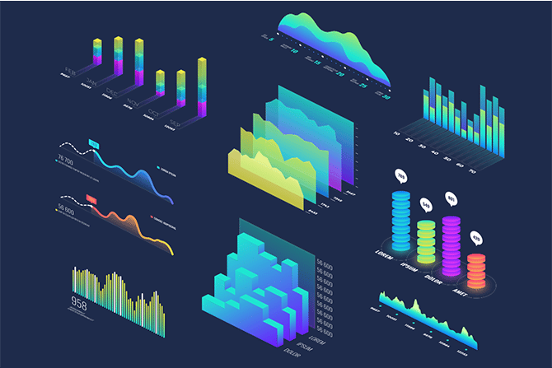
Why use visualizations?
Using visualizations helps tell the story to your targeted audience. It also provides a summary of your findings and answers the questions that the audience are looking for. It is a powerful tool when trying to formulate what the data means and how it can benefit or hinder the overall goals.

